Slide 1
Sad Explorer
Project: History Explorer
By: Yesenia Yser
Senior Project Fall 2014

Slide 2
Agenda:
Overall Idea of the Android System
Android Application Shortcomings
Android Application Missing feature
Overall idea of the Web Application
Web Application shortcomings
Web Application Missing features

Slide 3
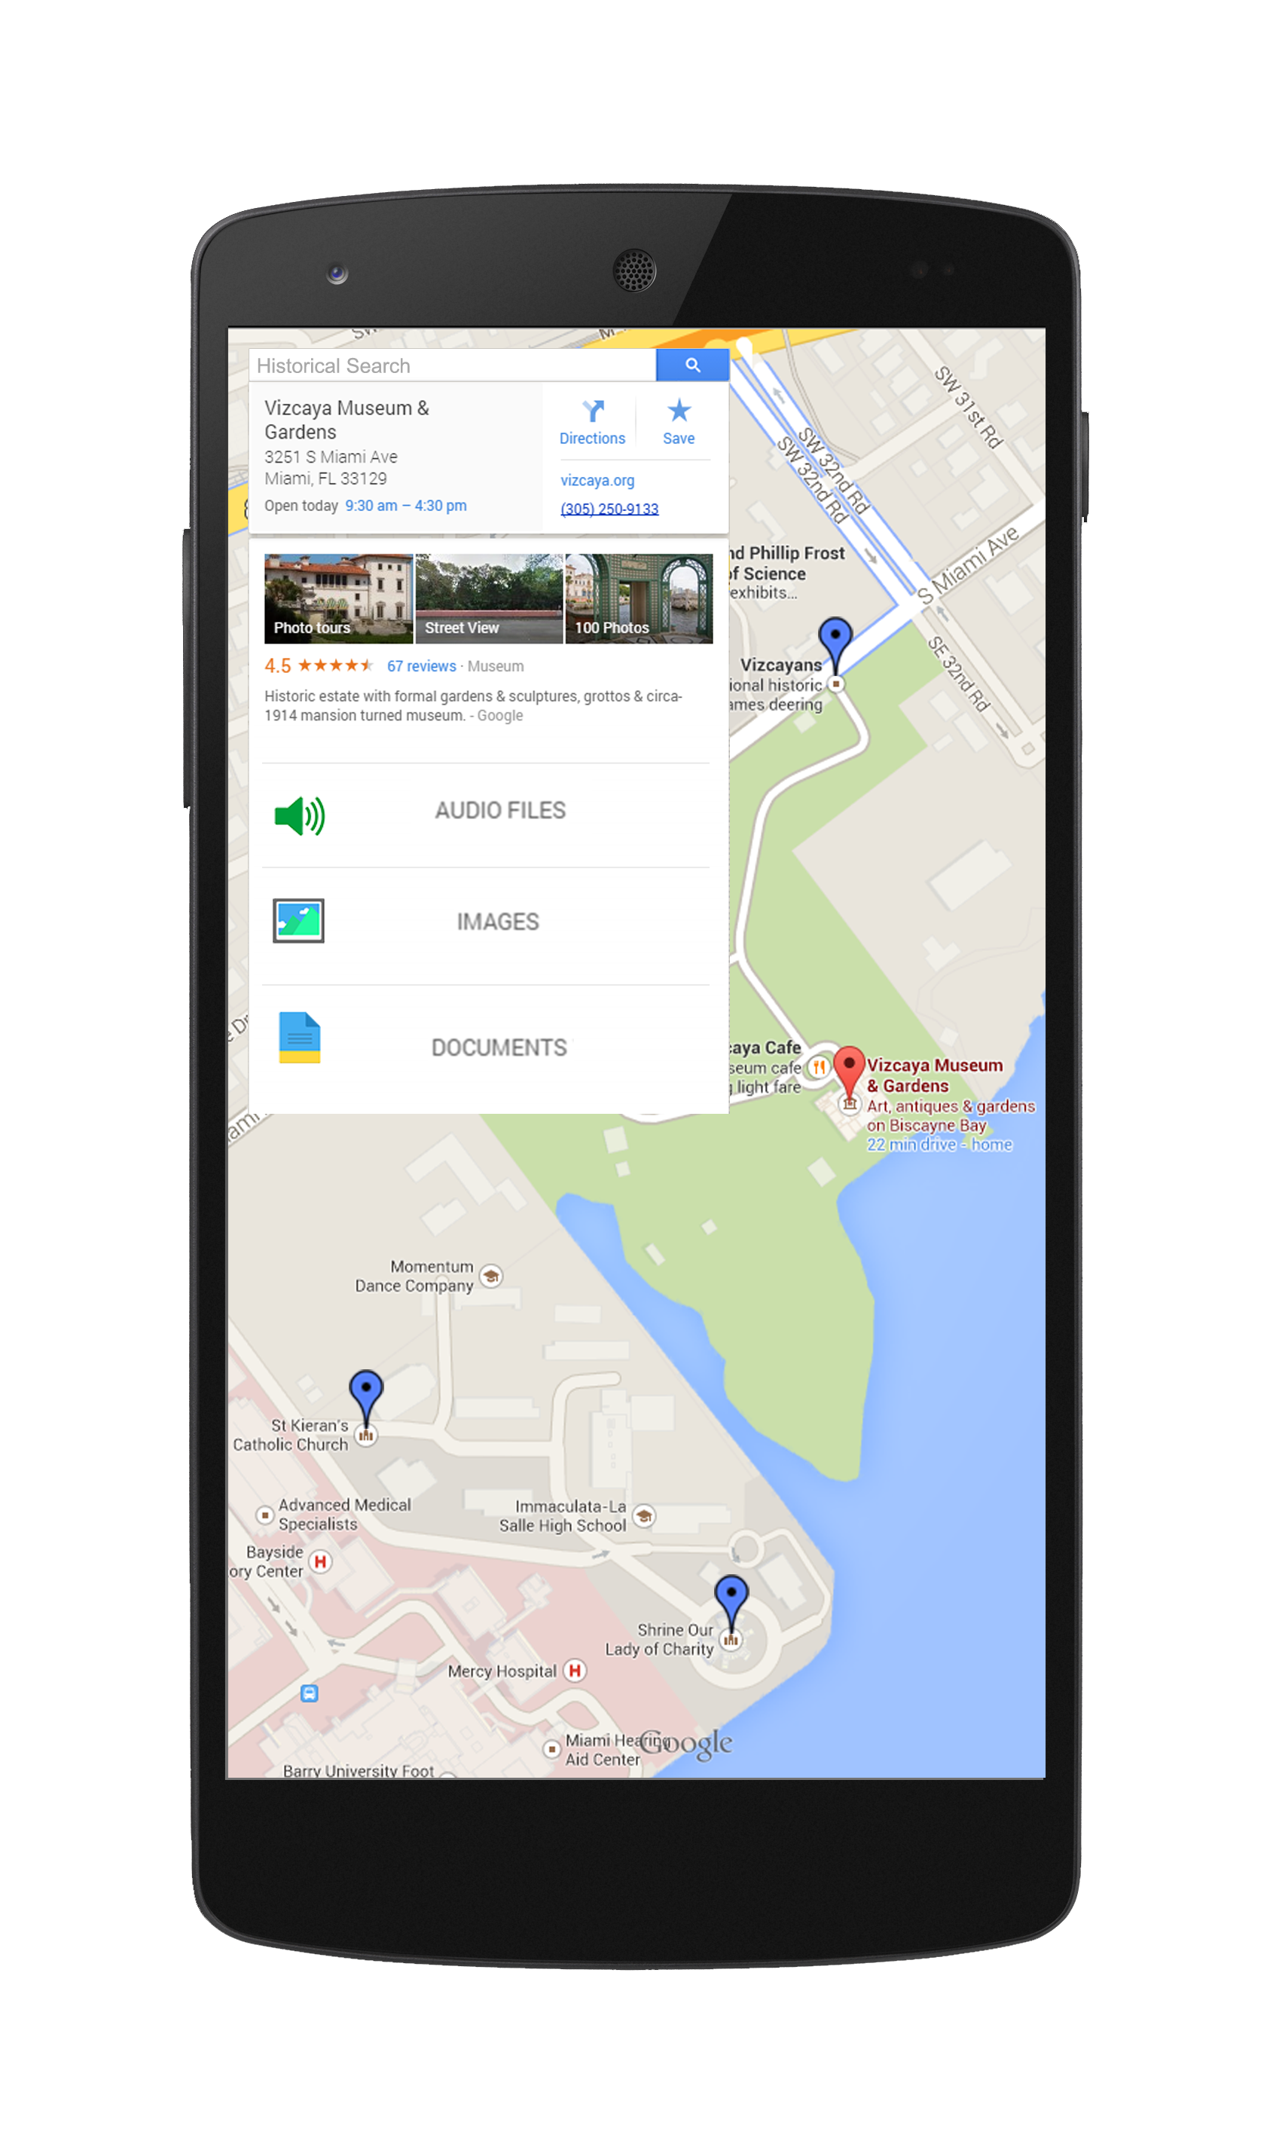
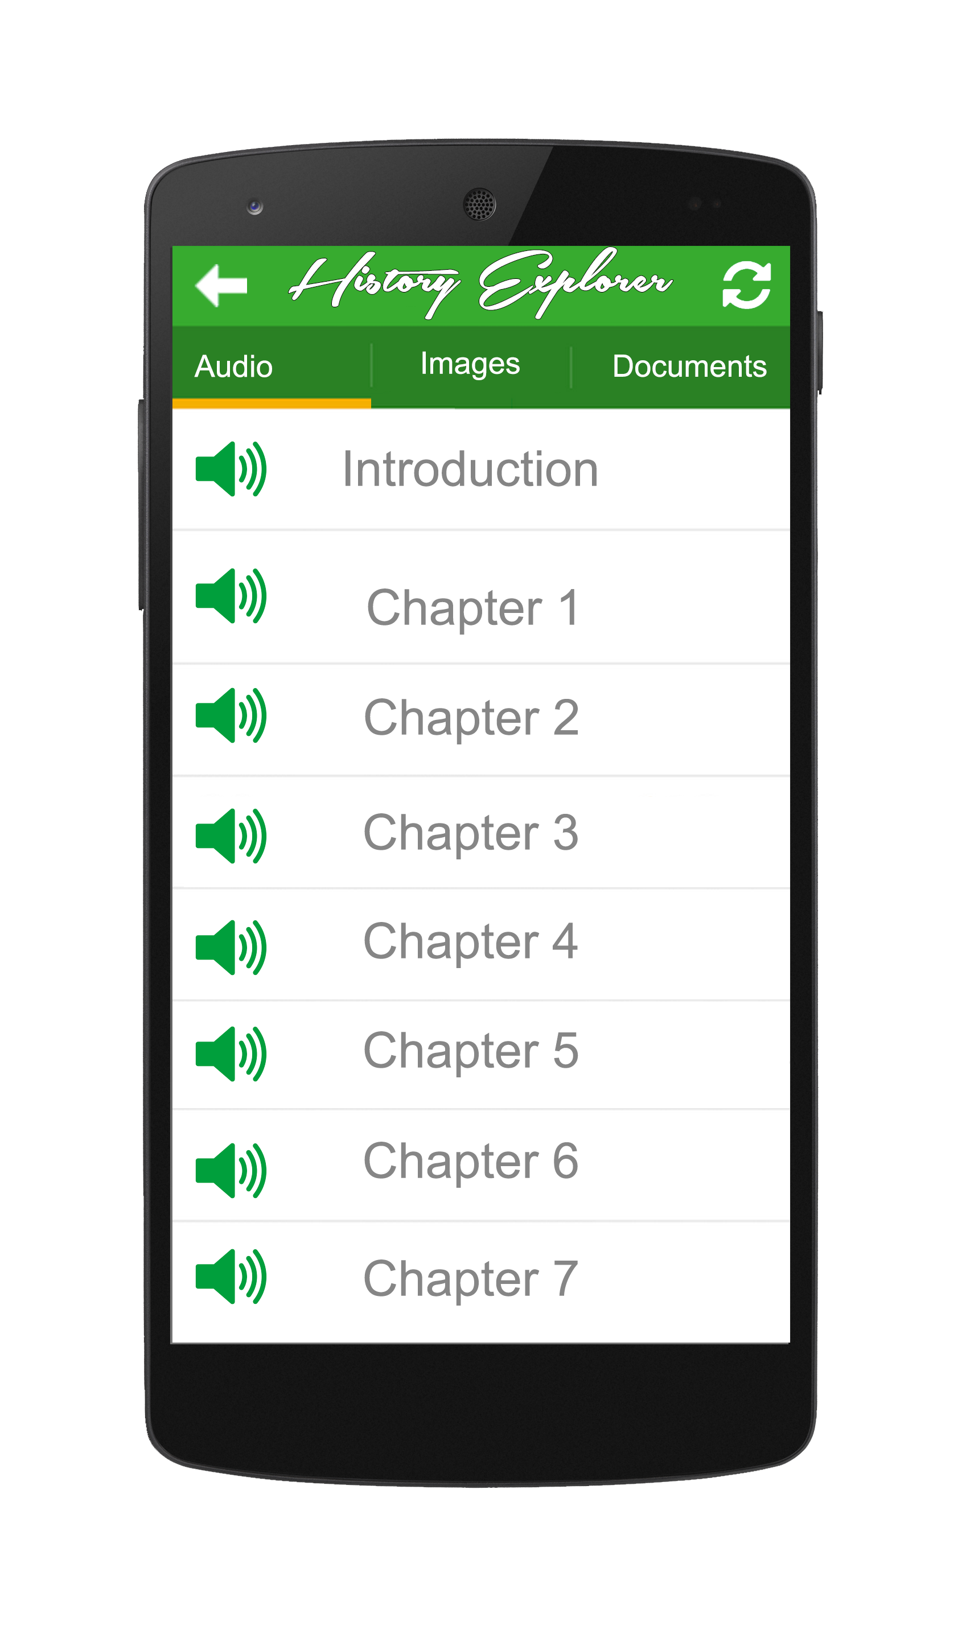
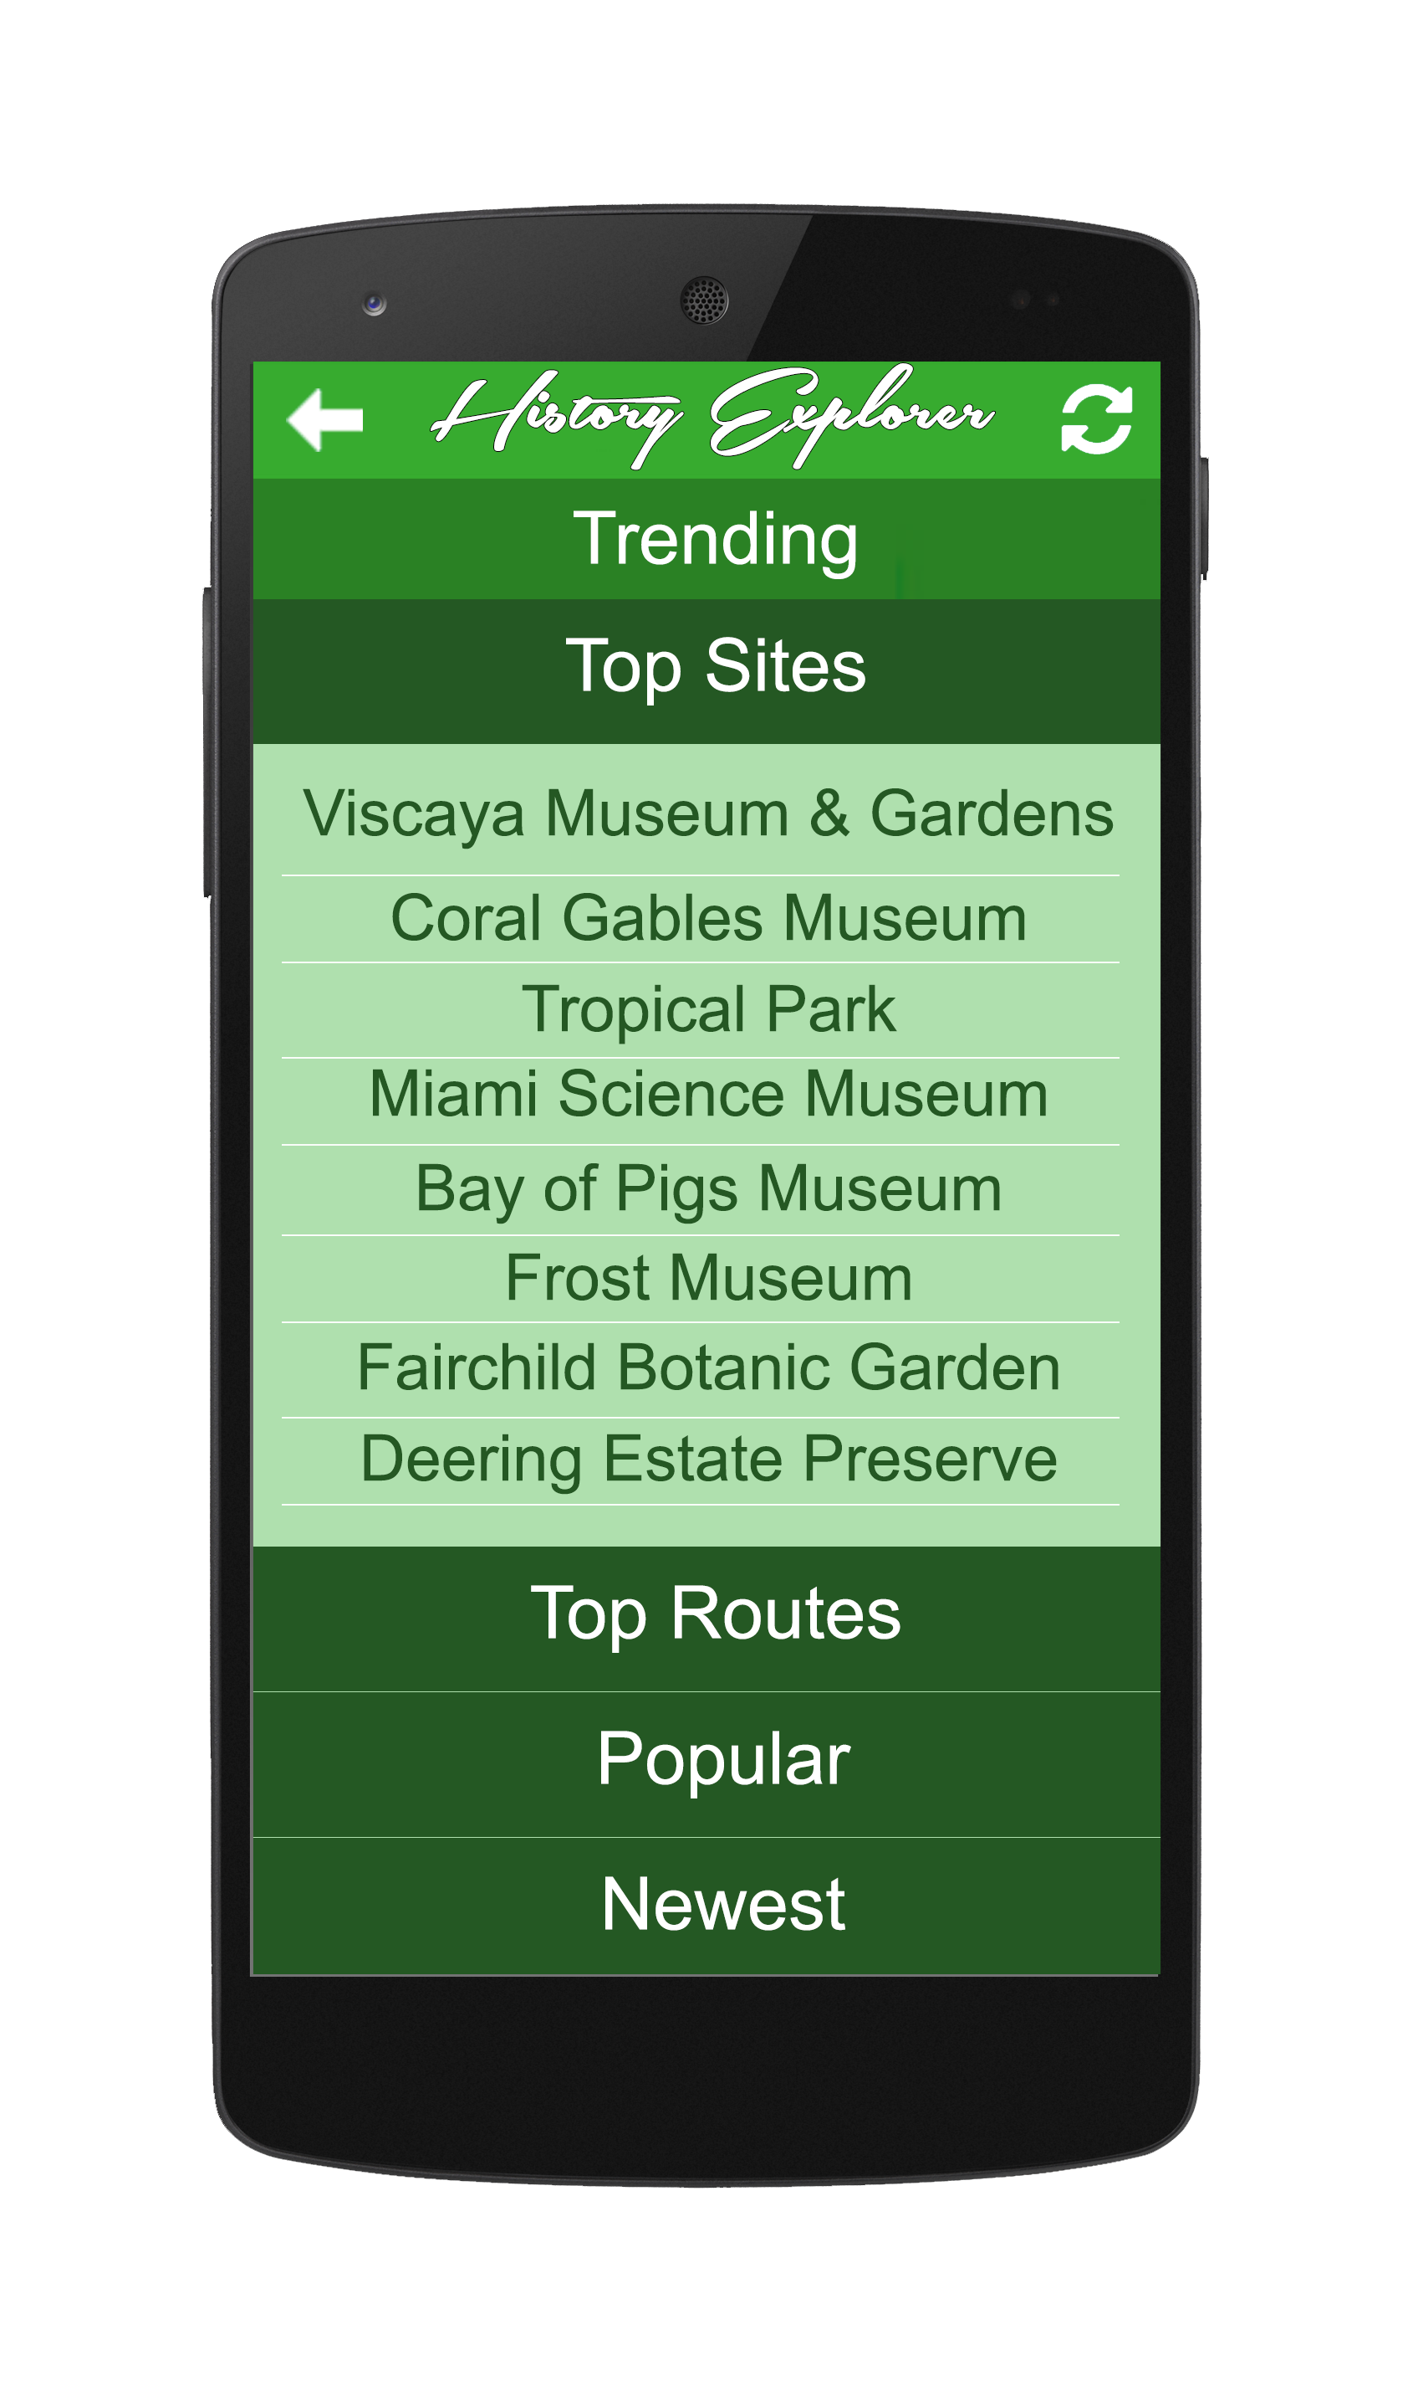
Overall idea of the Android System
Original Map Screen
Original Media Screen
Top Trending Idea

Slide 4
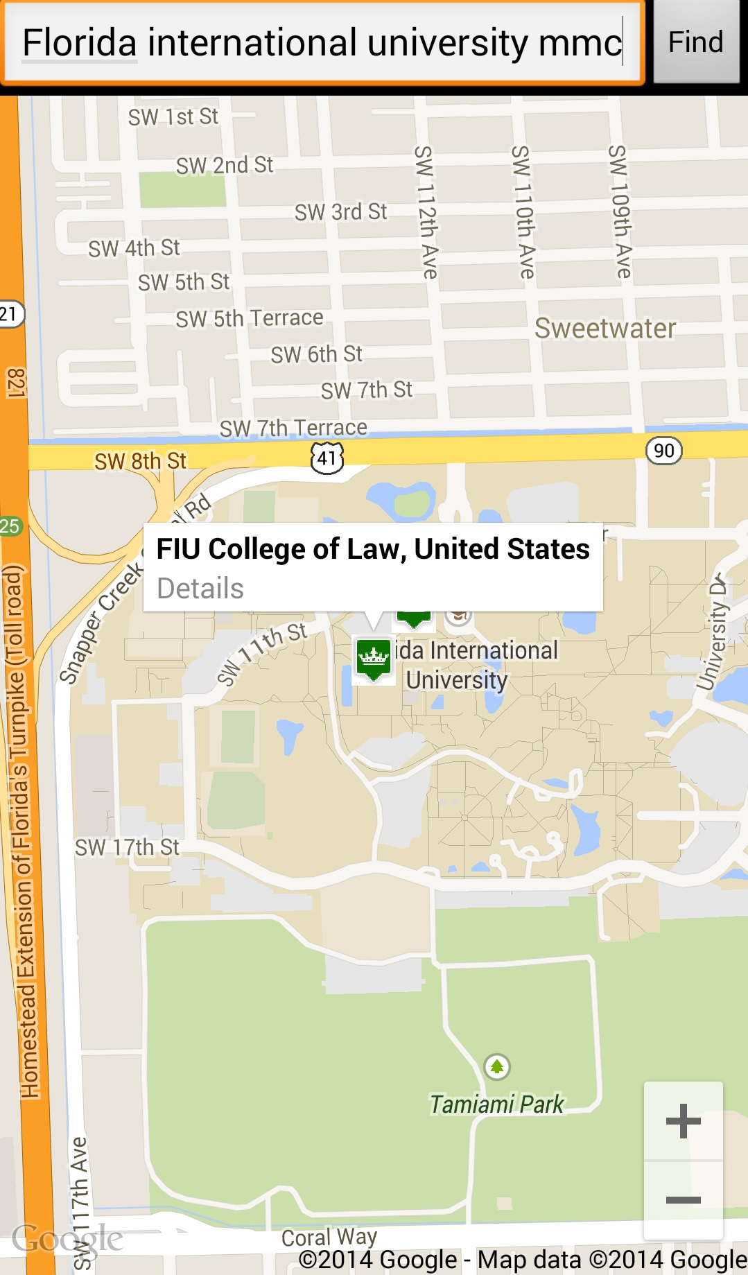
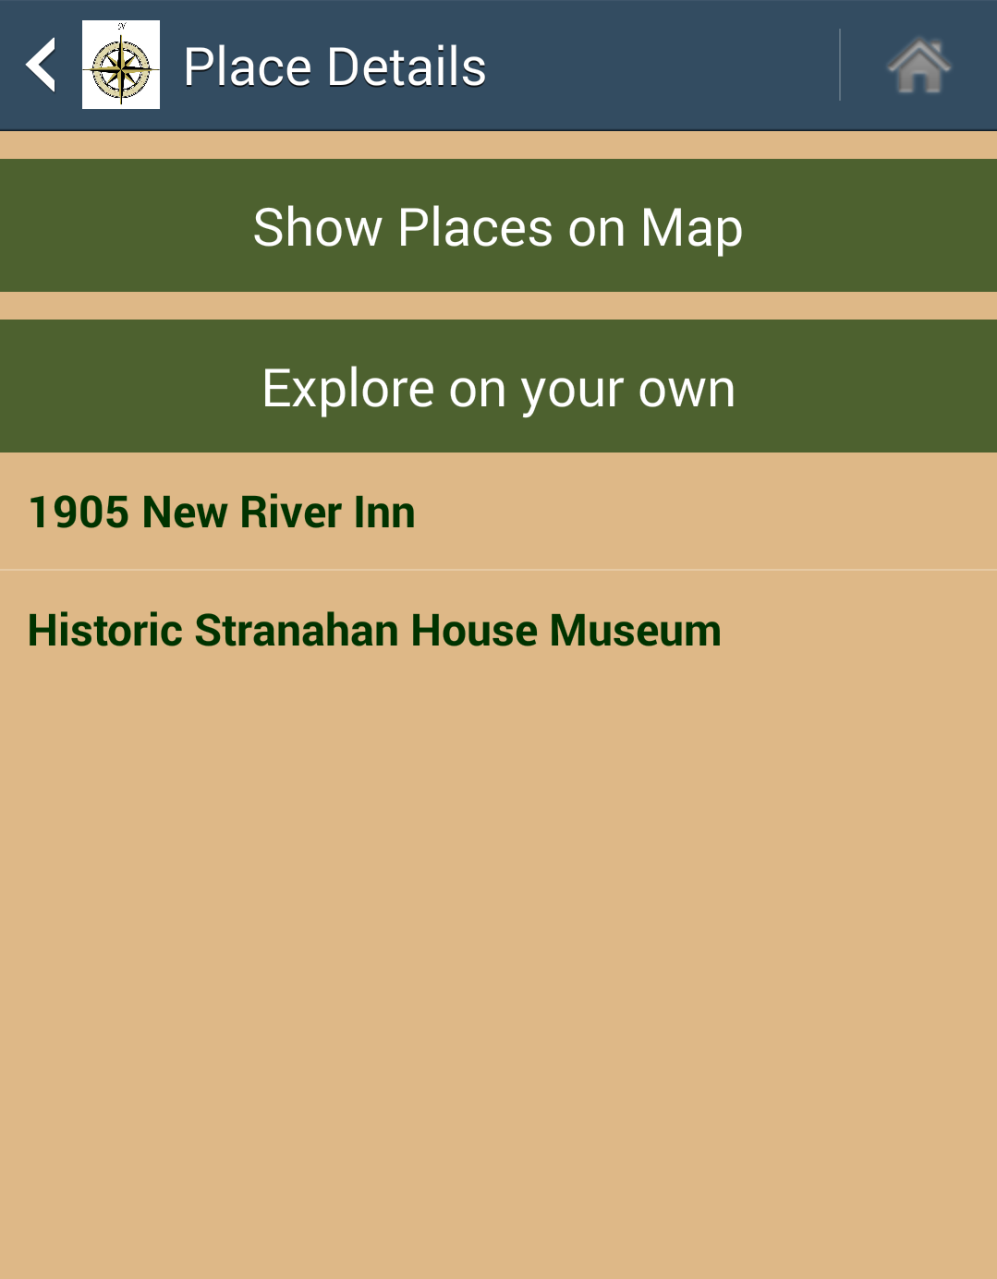
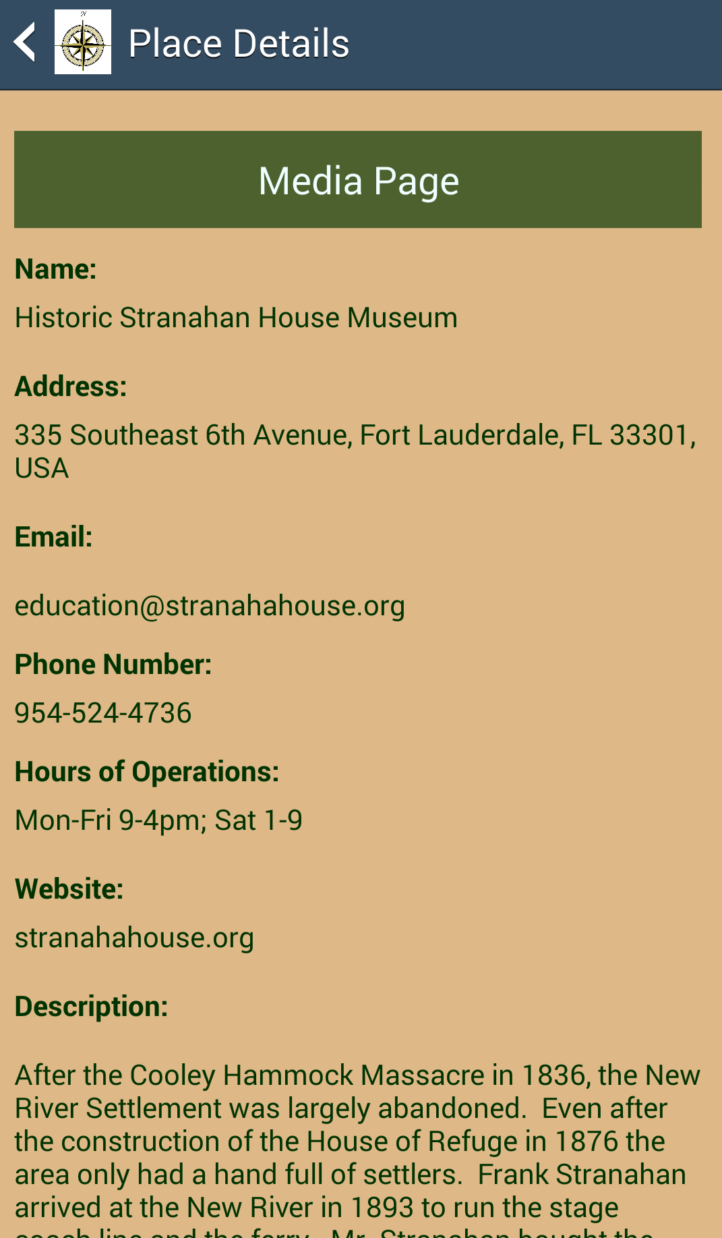
Shortcomings
Implemented Map Screen
Implemented Places Screen
Implemented Places Detail

Slide 5
Features Missing
Displaying Media Files associated with the Single place selected
Playing or downloading audio files
Reading or downloading document files
Displaying or downloading an image
Ability to generate a route
Ability to save a route
Ability to open a saved route
My Saved Route screen displaying saved routes (Drawer List View)
Creating a filter option for generating routes on the map screen
Ability to see the historical sites timeline per site
Recommending a site
“Explore on your own” showing places from the database (integrate the two maps)

Slide 6
Overall idea of the Web Application

Slide 7
Shortcomings

Slide 8
Features Missing: Web Application

